Slide 1
World Bank Point of View
The Impact of Various Factors on Countries

Slide 2
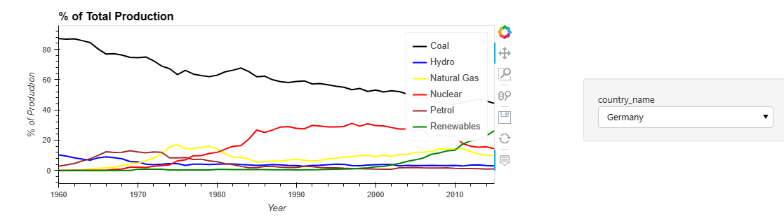
Electricity Production from sources
Germany produced 25% of its electricity from renewable sources (excluding hydroelectric) – which is the highest in any of the leading economies in the region

Slide 3
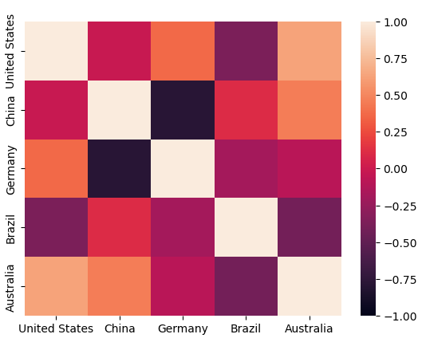
Is there a race amongst the leading economies
There is no identifiable pattern between the leading economies in producing electricity from Coal
Germany and China are negatively correlated.

Slide 4
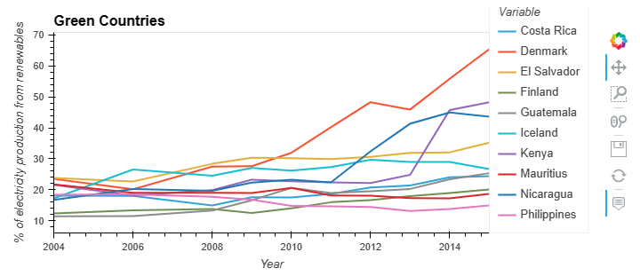
Green Countries
From a percentage standpoint, smaller countries have shown promise and increasing the electricity production from renewable resources from anywhere between 10-22% to 18-65%

Slide 5
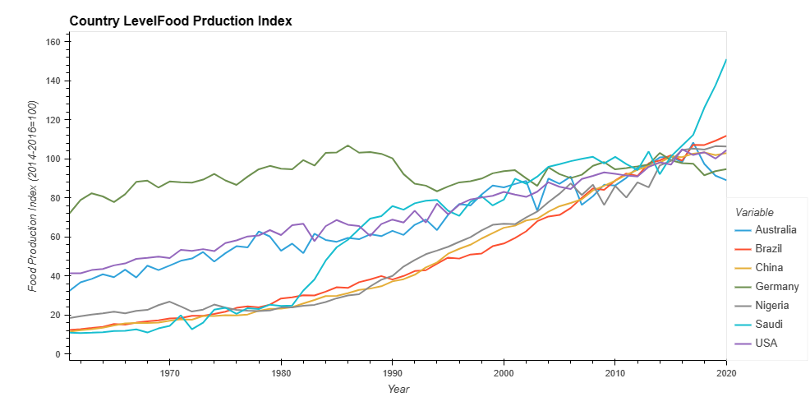
Food Production Trends
Growth in food production level for all countries
Germany has the lowest growth trend in the period.

Slide 6
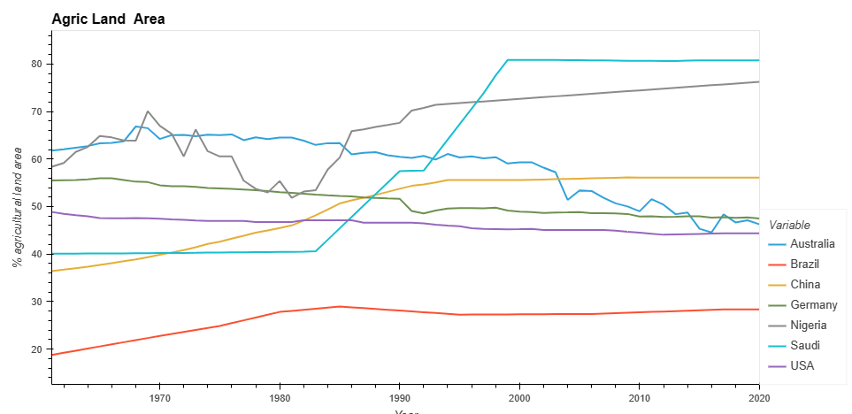
Agriculture Land Area Trends
Saudi Arabia doubled agric land area from 40.6% to 80.8%
Nigeria declined between 1970 and 1981 from 70.06% to 51.8% . Then went back to 70.7% between 1982 and 1992 .
Germany and United States registered a decline during the review period

Slide 7
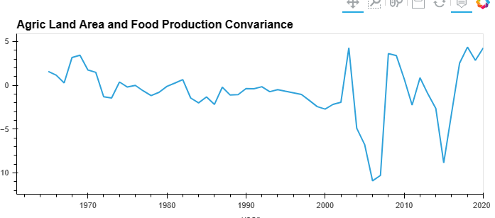
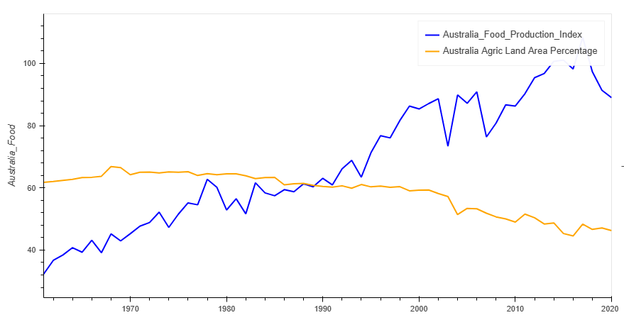
Australia Agric Land Vs Food Production
The magnitude of the changes in Australia's 5 year rolling daily food production values vs. the market agriculture land area did not remain constant over time.
Specifically, after 2003 there is no apparent relationship between the agriculture land area and the food production levels.

Slide 8
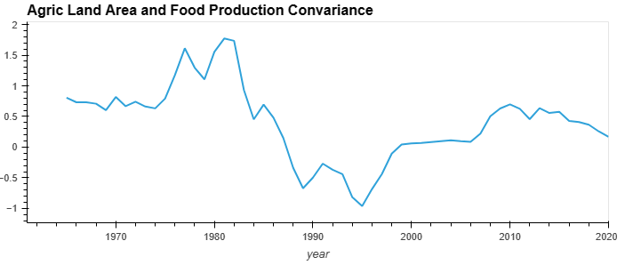
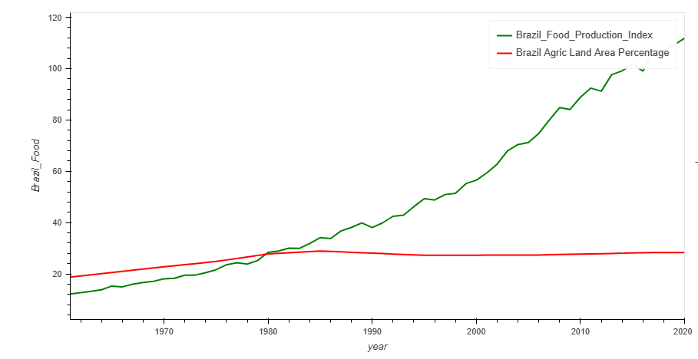
Brazil Agric Land Vs Food Production
Brazil has strong positive correlation between the agriculture land area and the food production to around 1985
After 1986 food production level increased although percentage of agriculture land area was constant.

Slide 9
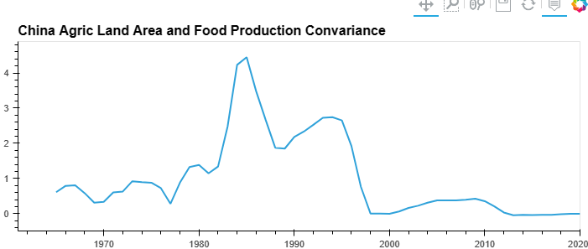
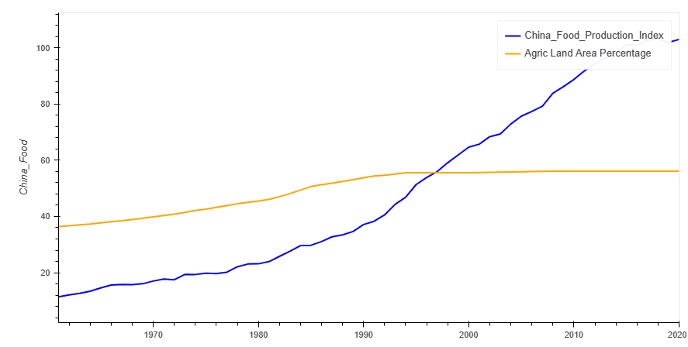
China Agric Land Vs Food Production
China exhibited some strong positive correlation between the agriculture land area and the food production levels up to 1997 but the correlation grew weaker during the later years of the review.

Slide 10
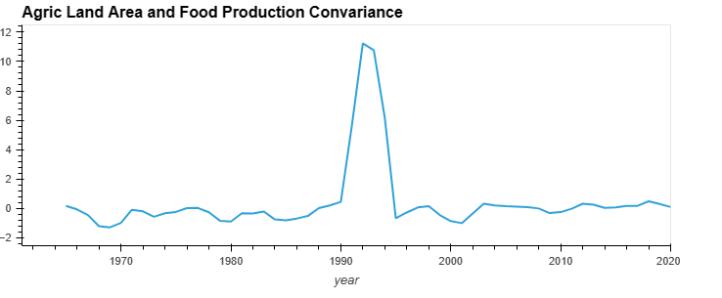
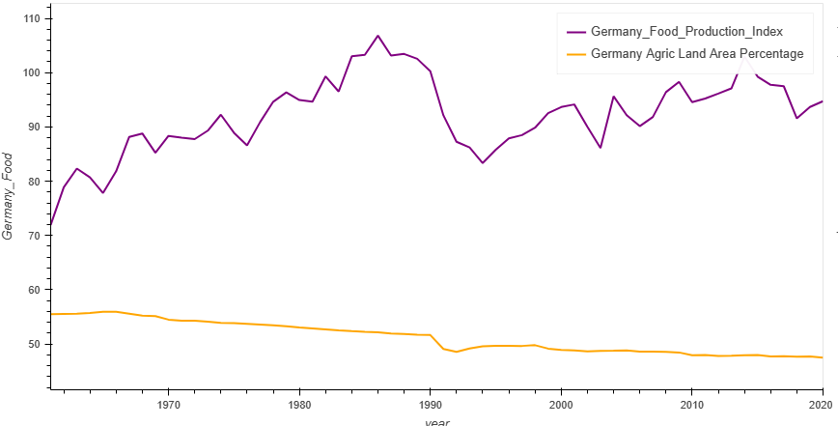
Germany Agric Land Vs Food Production
Except for 1992 which showed a strong positive correlation between the two matrices, Germany has exhibited a weak negative relationship between agriculture land area and food production levels during review period

Slide 11
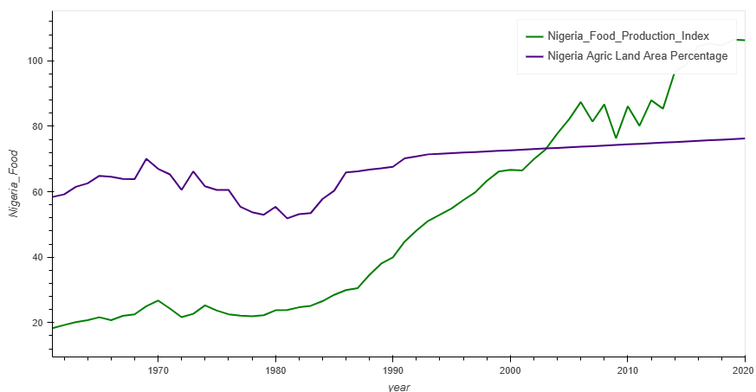
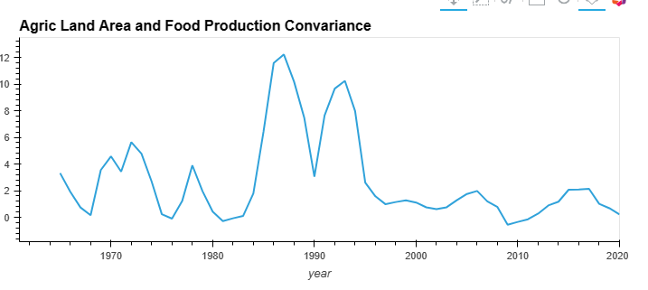
Nigeria Agric Land Vs Food Production
Nigeria Food production index was below the agriculture land area up 2003 when this trend reversed.
Strong positive relationship between Food production value and agriculture land area for Nigeria.

Slide 12
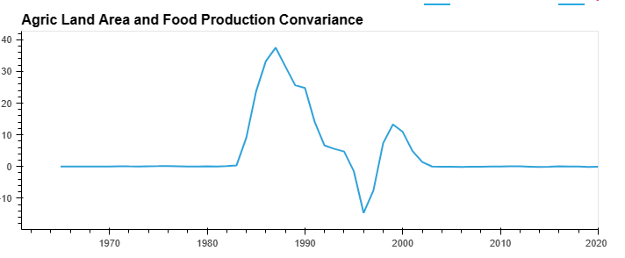
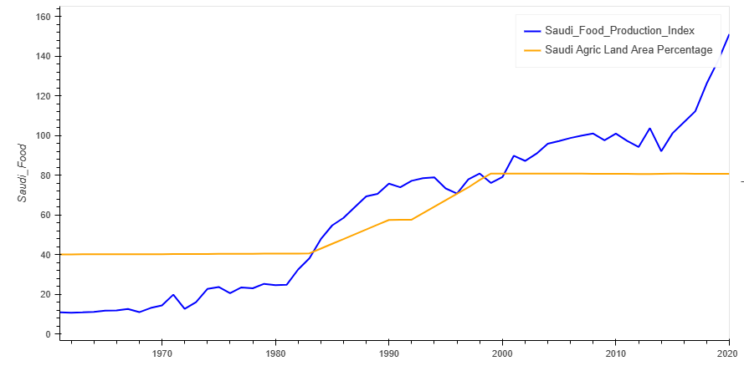
Saudi Arabia Agric Land Vs Food Production
Saudi Arabia apart from the period 1987 to 1994 where there a strong positive relationship between agriculture land area and food production, overall there is there is no relationship.

Slide 13
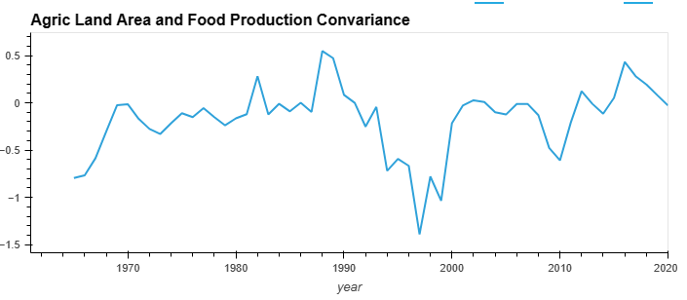
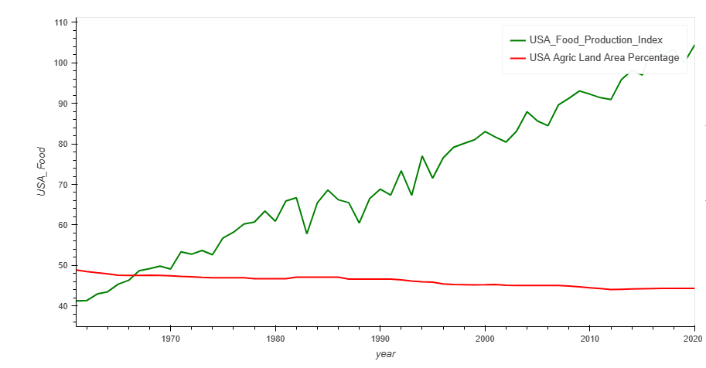
USA Agric Land Vs Food Production
USA had weak correlation between the agric land area and the food production levels ranging between -1.5 and 0.5

